Slide 1
Community Development Block Grant Program
El paso County Economic Development
NATASHA NORTH
PROJECT MANAGER
CDBG@elpasoco.com

Slide 2
Agenda
Access all Materials at:
admin.elpasoco.com/economic-development/cdbg/
Time | Task | Tools
5 min | Welcome & Introductions Distribute materials | Participant Packet - Handouts
5 min | CDBG Program Overview What is the history of the program? How do CDBG goals fulfill community needs? | 2022 Full Project Listing 2022 CDBG Income Limits
10 min | Connecting to Shared Themes What themes drive CDBG initiatives and goals? Which theme best exemplifies your organization’s practices?
50 min | CDBG Timeline – a “How-To” Guide What is the big picture overview of my project? How do I maintain timely reporting for my project? | CDBG Homepage Annual Reporting Schedule (One-Pager with Links) Sample Subrecipient Agreement CDBG Handbook
10 min | Kahoot – Review Quiz Use phones to access quiz; win a prize | Join the game at www.kahoot.it
5 min | Closing & Next Steps CDBG – Making an Impact | Project Budget & Timeline: Downloadable PDF or Electronic Form
Notes:
Natasha
5 min – welcome and introductions; distribute materials; reference the parking lot for questions (w/ contact name)

Slide 3
CDBG Program Overview

Slide 4
CDBG Program Overview What is the history of the program?
1974
The CDBG program began in 1974 and is one of the longest running Housing and Urban Development programs.
El Paso County was designated as a CDBG Entitlement Community in 2009.
Today, the Community Development Block Grant (CDBG) program is a federally funded, flexible program that provides communities with resources to address a wide range of unique community development needs.
2009
2022
Notes:
Delilah
2 min – briefly explain

Slide 5
CDBG Program Overview How do CDBG goals fulfill community needs?
General Goals
Community Development Needs
Public
Services
Economic
Development
Housing
Provide Decent Affordable Housing
Expand Economic Opportunities
Public
Facilities
Infrastructure
Establish
& Maintain Sustainable Living Environments
The County’s CDBG goals are consistent with the federal CDBG goals and the County’s Strategic Plan.
The County’s CDBG goal is to develop viable communities by ensuring a range of affordable housing choices, supporting necessary services, strengthening the local economy, and mobilizing community resources to enhance collaboration and community partnerships.
Additionally, the County’s CDBG program aims to provide effective planning and program administration.
Notes:
Delilah
3 min – briefly explain

Slide 6
Connecting to Shared Themes

Slide 7
Connecting to Shared Themes What themes drive CDBG initiatives and goals?
Partnerships
The County is very excited to be entering into a partnership with you, the subrecipients.
Our collaboration is vital for the success of the program.
Remember, the County and subrecipients share joint responsibility for carrying out permitted activities in compliance with applicable Federal requirements.
Regulatory Compliance & Performance
Performance measurement is an effective management technique that enables grantees to analyze the benefits of their investments.
We will discuss appropriate ways to measure your performance for CDBG reporting later in the session.
Documentation
The cardinal rule in using Federal funds is documentation.
The achievement of program goals and the completion of activities must be supported by adequate documentation of the facts.
Effective Management Practices
Support cooperative, proactive relationships among HUD, the County and subrecipients.
Work towards continuous improvement in both regulatory compliance and timely program performance.
Maintain open and frequent communication among all participants.
Focus on preventing problems first, rather that curing them later.
Notes:
Natasha
3 min – briefly explain (reference handout)

Slide 8
Connecting to Shared Themes Which theme best exemplifies your organization’s practices?
Share-Out
3 →
2 →
1 →
If you are joining virtually, please add your ideas to the chat!
On three sticky notes, write down 3 systems or procedures you currently utilize that support your organization’s pursuit of one or more of these themes.
Add your sticky notes to the corresponding posters. Gallery walk to 2 posters to discover and discuss ideas from others.
Come back together to share 1 innovative idea you heard, for the good of the larger group.
Partnerships
Regulatory Compliance
& Performance
Documentation
Effective Management Practices
Notes:
Natasha
7 min – explain activity, then do activity (ask virtual members to add ideas to the chat; quickly put them on sticky notes)

Slide 9
CDBG Timeline – a “How-To” Guide

Slide 10
CDBG Timeline – a “How-To” Guide What is the big picture overview of my project?
Notice of Award
You should have already received your Notice of Award from El Paso County indicating that your application is approved and for what amount.
Reminder – you CANNOT begin to incur either administrative or program costs associated with the project until:
HUD gives final approval
An Environmental Review is complete, and funds are released by HUD
A Subrecipient Agreement between you and EPC is fully and properly executed
You receive a Notice to Proceed letter from EPC
The County cannot reimburse any expense incurred prior to the effective date of the Subrecipient Agreement and Notice to Proceed document.
Notice of Award
Environmental Assessments
Orientation
Budget & Timeline
Subrecipient Agreement
Final HUD Approval
Notice to
Proceed
Reimbursement Requests
Quarterly Reports
Project
Monitoring
Expiration &
Close Out
Notes:
Delilah
2 min – briefly explain bolded items

Slide 11
CDBG Timeline – a “How-To” Guide What is the big picture overview of my project?
Environmental Assessments
This process can take a long time depending on your project’s complexity. Note steps below; CDBG staff facilitate these steps and may ask questions to expedite the process when needed.
State Historic Preservation Office
US Fish and Wildlife
Floodplain Management
Wetlands Protection
Sole Source Aquifers
Wild & Scenic Rivers Act
Air Quality
Farmland Protection
Environmental Justice
Noise Abatement & Control
Toxic Chemicals & Gases, Hazardous Materials, Contamination, & Radioactive Substances
Airport Clear Zones & Accident Potential Zones
Conformance with Comprehensive Plans & Zoning
Compatibility & Urban Impact
Slope
Soil Suitability
Hazards & Nuisances
Including Site Safety
Energy Consumption
Noise (contribution to community noise levels)
Air Quality (effects of ambient air quality on project & contribution to community pollution levels)
Environmental Design (visual quality; coherence, diversity, compatible use, & scale)
GENERAL EXAMPLES
LAND DEVELOPMENT
Demographic
Character Changes & Displacement
Employment & Income Patterns
SOCIOECONOMIC
Notice of Award
Environmental Assessments
Orientation
Budget & Timeline
Subrecipient Agreement
Final HUD Approval
Notice to
Proceed
Reimbursement Requests
Quarterly Reports
Project
Monitoring
Expiration &
Close Out
Notes:
Delilah
2 min – briefly explain

Slide 12
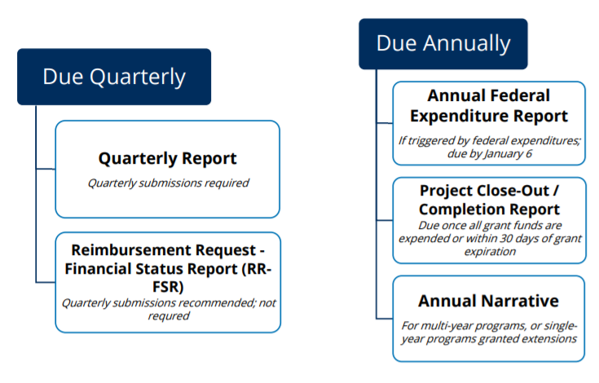
CDBG Timeline – a “How-To” Guide What is the big picture overview of my project?
Orientation Meeting
You are Here!
Learn about resources to support your
implementation of awarded CDBG funds:
The Subrecipient Handbook
CDBG Website + Annual Reporting Schedule
CDBG Support Staff
Notice of Award
Environmental Assessments
Orientation
Budget & Timeline
Subrecipient Agreement
Final HUD Approval
Notice to
Proceed
Reimbursement Requests
Quarterly Reports
Project
Monitoring
Expiration &
Close Out
Notes:
Natasha
3 min – mention links and opportunity to “gallery walk” resources in a few minutes; reminder about parking lot
Model how to find the “annual reporting” one-pager (hard copy + online)
Note that regular reminder emails will be sent out as well, every step of the way for quarterly deliverables.
NOTE: for construction session, point out the Davis Bacon docs on the website as well

Slide 13
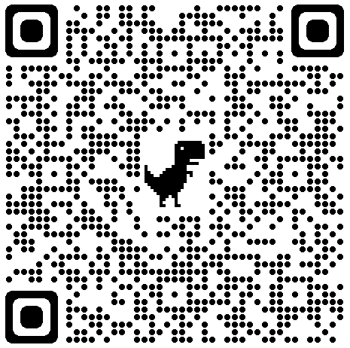
CDBG Timeline – a “How-To” Guide What is the big picture overview of my project?
Confirmation of Budget & Timeline
All project budgets and timelines must be confirmed by
September 16.
Three options for submitting your budget/timeline:
Use the QR Code
Submit the electronic form
Email the completed PDF to CDBG@elpasoco.com
It is important to be as accurate as possible since this will be included in your Subrecipient Agreement.
Notice of Award
Environmental Assessments
Orientation
Budget & Timeline
Subrecipient Agreement
Final HUD Approval
Notice to
Proceed
Reimbursement Requests
Quarterly Reports
Project
Monitoring
Expiration &
Close Out
Notes:
Natasha
3 min – THIS IS A NEXT STEP (due Sept 16)
NOTE: reference the budget page of their application (printed and in their folders)
Explain THIS WILL BE USED in a LEGAL agreement! Be careful to make it accurate.

Slide 14
CDBG Timeline – a “How-To” Guide What is the big picture overview of my project?
Subrecipient Agreement (SRA)
The SRA is the contract between you and the County that clearly states details about:
Project Description
Financial Management
Federal Conditions & Requirements
Administrative Requirements
Personnel & Beneficiary Conditions
Environmental Assessments
Please note – you will have one year from the date indicated on your SRA to expend your CDBG funds.
Proactively maintaining your budget and timeline will ensure you are able to expend all funds prior to the expiration date.
Please contact us immediately if you encounter problems that will likely affect your proposed budget or timeline.
Notice of Award
Environmental Assessments
Orientation
Budget & Timeline
Subrecipient Agreement
Final HUD Approval
Notice to
Proceed
Reimbursement Requests
Quarterly Reports
Project
Monitoring
Expiration &
Close Out
Notes:
Delilah
3 min – reference link example

Slide 15
CDBG Timeline – a “How-To” Guide What is the big picture overview of my project?
Final HUD Approval
If all previously mentioned steps are complete, then EPC requests the release of funds from HUD.
After approval from HUD is finalized, you will receive a Notice to Proceed letter indicating permission to:
Begin incurring project costs
Begin submitting Reimbursement Request forms
Notice of Award
Environmental Assessments
Orientation
Budget & Timeline
Subrecipient Agreement
Final HUD Approval
Notice to
Proceed
Reimbursement Requests
Quarterly Reports
Project
Monitoring
Expiration &
Close Out
Notes:
Delilah
1 min – briefly explain

Slide 16
CDBG Timeline – a “How-To” Guide What is the big picture overview of my project?
Notice to Proceed
Your Notice to Proceed letter means that our request with HUD has been approved and you may now:
Incur project costs
Submit Reimbursement Request forms
Remember – any expenses incurred prior to receiving the Notice to Proceed letter will NOT be reimbursed.
Notice of Award
Environmental Assessments
Orientation
Budget & Timeline
Subrecipient Agreement
Final HUD Approval
Notice to
Proceed
Reimbursement Requests
Quarterly Reports
Project
Monitoring
Expiration &
Close Out
Notes:
Delilah
1 min – briefly explain

Slide 17
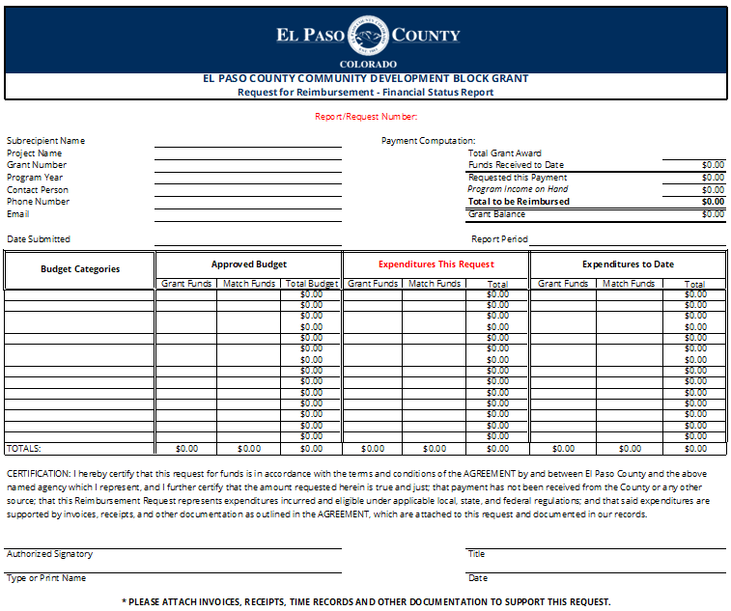
CDBG Timeline – a “How-To” Guide How do I maintain timely reporting for my project?
Reimbursement Request Form
Sample Exercise for Public Service, Housing, & Economic Development Projects:
Read the scenario provided in your handouts.
Then work with a partner to complete the reimbursement request form.
Also list possible backup documents you might include for this scenario.
Notice of Award
Environmental Assessments
Orientation
Budget & Timeline
Subrecipient Agreement
Final HUD Approval
Notice to
Proceed
Reimbursement Requests
Quarterly Reports
Project
Monitoring
Expiration &
Close Out
Notes:
Natasha/Delilah
10 min – Activity
Model how to find the RR form + instructions tab within the “annual reporting” one-pager online (also include hard copy for this activity)
Allow partners to read the scenario and complete a form. Walk around and answer questions as needed.
Note that regular email reminders will be sent out as well.

Slide 18
CDBG Timeline – a “How-To” Guide How do I maintain timely reporting for my project?
Reimbursement Request Form
IMPORTANT NOTE:
CDBG is a reimbursement grant to the subrecipient.
As such, backup documents must show that the subrecipient has already paid a contractor’s invoices. The company invoices alone are insufficient.
Additionally, all Davis Bacon payroll for the work completed to date must also be submitted correctly prior to a reimbursement request.
Sample Exercise for Public Facilities & Infrastructure Projects:
Read the scenario provided in your handouts.
Then work with a partner to complete the reimbursement request form.
Also list possible backup documents you might include for this scenario.
Notice of Award
Environmental Assessments
Orientation
Budget & Timeline
Subrecipient Agreement
Final HUD Approval
Notice to
Proceed
Reimbursement Requests
Quarterly Reports
Project
Monitoring
Expiration &
Close Out
Notes:
Natasha/Delilah
10 min – Activity
Model how to find the RR form + instructions tab within the “annual reporting” one-pager online (also include hard copy for this activity)
Allow partners to read the scenario and complete a form. Walk around and answer questions as needed.
Note that regular email reminders will be sent out as well.
(Construction sessions only)

Slide 19
CDBG Timeline – a “How-To” Guide How do I maintain timely reporting for my project?
Quarterly Report Form
You will submit Quarterly Reports summarizing how well you are executing your planned project.
These reports consist of:
Narratives of your project’s progress (budget, timeline, etc.)
Data collected from clients
Demographics of persons served
Quarterly Reports are a requirement of the Subrecipient Agreement.
Quarter | Reporting Period | Reports Due By
1st Quarter | April 1 – June 30 | July 15
2nd Quarter | July 1 – Sept 30 | October 14
3rd Quarter | Oct 1 – Dec 31 | January 6*
4th Quarter | Jan 1 – March 31 | April 14
*Date subject to change depending on EPC Finance end-of-year calendar
Notice of Award
Environmental Assessments
Orientation
Budget & Timeline
Subrecipient Agreement
Final HUD Approval
Notice to
Proceed
Reimbursement Requests
Quarterly Reports
Project
Monitoring
Expiration &
Close Out
Notes:
Natasha
5 min – Model how to find the QR and Demographics form within the “annual reporting” one-pager online (also refer to the hard copy)

Slide 20
CDBG Timeline – a “How-To” Guide How do I maintain timely reporting for my project?
Monitoring and Site Visits
BEFORE: You will receive two weeks’ notice prior to a monitoring visit.
DURING: The monitoring section of your handbook provides examples of look-fors* during a visit.
AFTER: Following a visit, you will receive an evaluation report with feedback.
*Additional look-fors may apply; Davis Bacon and Program Income regulations will be monitored as well.
Notice of Award
Environmental Assessments
Orientation
Budget & Timeline
Subrecipient Agreement
Final HUD Approval
Notice to
Proceed
Reimbursement Requests
Quarterly Reports
Project Monitoring
Expiration &
Close Out
Notes:
Delilah
2 min – briefly explain

Slide 21
CDBG Timeline – a “How-To” Guide How do I maintain timely reporting for my project?
Expiration of Subrecipient Agreements & Project Close-Out/Completion Report
Upon expiration of your Subrecipient Agreement, your CDBG project should be complete and all CDBG awarded funds should be expended.
Any funds not expended by the SRA expiration date are returned to the County for reprogramming.
Submit a Project Close-Out/Completion Report when the SRA expires.
Keep all project files for at least 5 years after close-out in case of a HUD audit or monitoring questions.
CDBG funds cannot be used for any expense incurred after the expiration date in the Subrecipient Agreement.
Notice of Award
Environmental Assessments
Orientation
Budget & Timeline
Subrecipient Agreement
Final HUD Approval
Notice to
Proceed
Reimbursement Requests
Quarterly Reports
Project
Monitoring
Expiration &
Close Out
Notes:
Delilah
3 min – Model how to find the Project Close Out form within the “annual reporting” one-pager online (also refer to hard copy)

Slide 22
Making Davis-Bacon Work Specific Requirements for Construction Projects
Davis-Bacon Explained (2-Min Video)
Notes:
Delilah
2 min – overview video of Davis-Bacon
(Construction sessions only)

Slide 23
Making Davis-Bacon Work Specific Requirements for Construction Projects
Required Items for RFPs/IFBs
Request for Proposal (RFP’s) & Invitation for Bid (IFB’s)
Required HUD forms that must be part of the procurement (RFP/IFB) package include:
HUD Form 4010
HUD Form 92554M
Applicable Prevailing Wages
(Pulled from sam.gov; our office can also assist with pulling these.)
SAM.GOV
The SAM.gov website is an important resource for two reasons:
Prevailing wages are pulled from this site.
All contractors must be registered in this system and not federally debarred to be awarded a contract that utilizes CDBG funding. Confirmation of this registration must be sent to our office before a contract is awarded.
Notes:
Delilah
2 min – brief explanation; time for questions
(Construction sessions only)

Slide 24
Making Davis-Bacon Work Specific Requirements for Construction Projects
Certified Payroll
Prevailing Wages + Fringe Benefits:
If you are not contributing the funds to one of the acceptable benefits above, then the fringe benefit must be paid out in cash to the employee.
A Contractor’s Guide to Davis-Bacon & Labor Standards is available on our website.
Being familiar with this guide is vital to federal regulation compliance success!
Ensure all payroll forms are accurate, including proper classification of each employee and the work they’re performing.
Health Insurance Premiums | Contributions Required by Federal, State, or Local Laws
Retirement Contributions | Social Security
Life Insurance | October 14
Vacation | Some Disability Insurance
Other Paid Leave | April 14
Notes:
Delilah
2 min – brief explanation; time for questions
(Construction sessions only)

Slide 25
Making Davis-Bacon Work Specific Requirements for Construction Projects
Onsite Interviews
On Construction Site:
Submit Certified Payroll and Construction Activity Reports to
CDBG@elpasoco.com
What to Post | What to Submit
Prevailing Wages Posted | Certified Payroll: Submitted Weekly via Email (Originals w/ signature sent at project closeout)
Davis Bacon Poster Posted | Construction Activity Report: Submitted ASAP
El Paso County staff will conduct on-site interviews to verify certified payrolls.
These interviews take only a few minutes and usually a sample of your workers are asked to participate.
Notes:
Delilah
2 min – brief explanation; time for questions
(Construction sessions only)

Slide 26
Kahoot
Review
Quiz
Join the game at:
www.Kahoot.it
Type in the Game PIN
Type in your First Name
Click to Join!
Notes:
Natasha
10 min – prep Kahoot game ahead of time to get join PIN (add the PIN to the chat for virtual participants)

Slide 27
Closing &
Next Steps

Slide 28
Closing & Next Steps CDBG – Making an Impact
THANK YOU
Thank you for your commitment to creating and maintaining vibrant communities!
Your CDBG projects make a lasting, positive impact on our local economy and its residents.
$2,196,139
$1,182,290
$1,011,327
$990,408
$816,065
$848,325
$873,222
$883,318
$792,971
$516,222
$658,142
Notes:
Delilah
3 min – briefly explain; gratitude for service to community

Slide 29
Community Development Block Grant Program
El paso County Economic Development
For additional information, please contact:
CDBG@elpasoco.com
Notes:
Delilah
2 min - Reminder to reach out with any questions as the process continues; please remember to complete the Budget/Timeline form before Sept 16.

